Slide 1
Dynamic Programming

Slide 2
DP - Two key ingredients
Two key ingredients for an optimization problem to be suitable for a dynamic-programming solution:
1. optimal substructures
2. overlapping subproblems
Subproblems are dependent.
(otherwise, a divide-and-conquer approach is the choice.)
Each substructure is optimal.
(Principle of optimality)

Slide 3
Three basic components
The development of a dynamic-programming algorithm has three basic components:
  The recurrence relation (for defining the value of an optimal solution);
  The tabular computation (for computing the value of an optimal solution);
  The traceback (for delivering an optimal solution).

Slide 4
Dynamic Programming Algorithm
Characterize the structure of an optimal solution
Recursively define the value of an optimal solution
Compute the value of an optimal solution in a bottom-up fashion
Construct an optimal solution from computed information

Slide 5
Longest Common Subsequence (LCS)
Application: comparison of two DNA strings
Ex: X= {A B C B D A B }, Y= {B D C A B A}
Longest Common Subsequence:
X = A B C B D A B
Y = B D C A B A
Brute force algorithm would compare each subsequence of X with the symbols in Y

Slide 6
Longest Common Subsequence
Given two sequences
X = ⟨x₁, x₂, …, x_{m}⟩
Y = ⟨y₁, y₂, …, y_{n}⟩
find a maximum length common subsequence (LCS) of X and Y
E.g.:
X = ⟨A, B, C, B, D, A, B⟩
Subsequences of X:
  A subset of elements in the sequence taken in order
⟨A, B, D⟩, ⟨B, C, D, B⟩, etc.

Slide 7
Example
X = ⟨A, B, C, B, D, A, B⟩ X = ⟨A, B, C, B, D, A, B⟩
Y = ⟨B, D, C, A, B, A⟩ Y = ⟨B, D, C, A, B, A⟩
⟨B, C, B, A⟩ and ⟨B, D, A, B⟩ are longest common subsequences of X and Y (length = 4)
⟨B, C, A⟩, however is not a LCS of X and Y

Slide 8
Brute-Force Solution
For every subsequence of X, check whether it’s a subsequence of Y
There are 2^{m} subsequences of X to check
Each subsequence takes Θ(n) time to check
  scan Y for first letter, from there scan for second, and so on
Running time: Θ(n2^{m})

Slide 9

LCS Algorithm
First we’ll find the length of LCS. Later we’ll modify the algorithm to find LCS itself.
Define X_{i}, Y_{j} to be the prefixes of X and Y of length i and j respectively
Define c[i,j] to be the length of LCS of X_{i} and Y_{j}
Then the length of LCS of X and Y will be c[m,n]

Slide 10
LCS recursive solution
We start with i = j = 0 (empty substrings of x and y)
Since X₀ and Y₀ are empty strings, their LCS is always empty (i.e. c[0,0] = 0)
LCS of empty string and any other string is empty, so for every i and j: c[0, j] = c[i,0] = 0

Slide 11
LCS recursive solution
When we calculate c[i,j], we consider two cases:
First case: x[i]=y[j]:
  one more symbol in strings X and Y matches, so the length of LCS X_{i} and Y_{j} equals to the length of LCS of smaller strings X_{i-1} and Y_{i-1} , plus 1

Slide 12
LCS recursive solution
Second case: x[i] != y[j]
  As symbols don’t match, our solution is not improved, and the length of LCS(X_{i} , Y_{j}) is the same as before (i.e. maximum of LCS(X_{i}, Y_{j-1}) and LCS(X_{i-1},Y_{j})
Why not just take the length of LCS(X_{i-1}, Y_{j-1}) ?

Slide 13
3. Computing the Length of the LCS
  0 if i = 0 or j = 0
  c[i, j] = c[i-1, j-1] + 1 if x_{i} = y_{j}
  max(c[i, j-1], c[i-1, j]) if x_{i} ≠ y_{j}
0
1
2
n
y_{j:}
y₁
y₂
y_{n}
0
x_{i}
0 | 0 | 0 | 0 | 0 | 0
0
0
0
0
0
1
x₁
first
2
x₂
second
i
m
x_{m}
j

Slide 14
Additional Information
  0 if i,j = 0
c[i, j] = c[i-1, j-1] + 1 if x_{i} = y_{j}
  max(c[i, j-1], c[i-1, j]) if x_{i} ≠ y_{j}
A matrix b[i, j]:
For a subproblem [i, j] it tells us what choice was made to obtain the optimal value
If x_{i} = y_{j}
b[i, j] = “ ”
Else, if c[i - 1, j] ≥ c[i, j-1]
b[i, j] = “ ↑ ”
else
b[i, j] = “ ← ”
b & c:
0
1
2
3
n
y_{j:}
A
C
D
F
0
x_{i}
0 | 0 | 0 | 0 | 0 | 0
0
0
0
0
0
1
A
2
B
c[i-1,j]
i
3
C
c[i,j-1]
m
D
j

Slide 15
LCS-LENGTH(X, Y, m, n)
for i ← 1 to m
do c[i, 0] ← 0
for j ← 0 to n
do c[0, j] ← 0
for i ← 1 to m
do for j ← 1 to n
do if x_{i} = y_{j}
then c[i, j] ← c[i - 1, j - 1] + 1
b[i, j ] ← “ ”
else if c[i - 1, j] ≥ c[i, j - 1]
then c[i, j] ← c[i - 1, j]
b[i, j] ← “↑”
else c[i, j] ← c[i, j - 1]
b[i, j] ← “←”
return c and b
The length of the LCS if one of the sequences
is empty is zero
Case 1: x_{i} = y_{j}
Case 2: x_{i} ≠ y_{j}
Running time: Θ(mn)

Slide 16
Example
  0 if i = 0 or j = 0
  c[i, j] = c[i-1, j-1] + 1 if x_{i} = y_{j}
  max(c[i, j-1], c[i-1, j]) if x_{i} ≠ y_{j}
X = ⟨A, B, C, B, D, A⟩
Y = ⟨B, D, C, A, B, A⟩
0
1
2
3
4
5
6
If x_{i} = y_{j}
b[i, j] = “ ”
Else if c[i - 1, j] ≥ c[i, j-1]
b[i, j] = “ ↑ ”
else
b[i, j] = “ ← ”
y_{j}
B
D
C
A
B
A
0
x_{i}
0
0
0
0
0
0
0
1
A
0
↑
0
↑
0
↑
0
1
1
←1
2
B
0
1
↑
1
2
←1
←1
←2
3
C
0
↑
1
↑
1
2
↑
2
↑
2
←2
4
B
0
1
↑
1
↑
2
↑
2
3
←3
5
D
0
↑
1
2
↑
2
↑
2
↑
3
↑
3
6
A
0
↑
1
↑
2
↑
2
3
↑
3
4
7
B
0
1
↑
2
↑
2
↑
3
4
↑
4

Slide 17
4. Constructing a LCS
Start at b[m, n] and follow the arrows
When we encounter a “ “ in b[i, j] ⇒ x_{i} = y_{j} is an element of the LCS
0
1
2
3
4
5
6
y_{j}
B
D
C
A
B
A
0
x_{i}
0
0
0
0
0
0
0
1
A
0
↑
0
↑
0
↑
0
1
1
←1
2
B
0
1
↑
1
2
←1
←1
←2
3
C
0
↑
1
↑
1
2
↑
2
↑
2
←2
4
B
0
1
↑
1
↑
2
↑
2
3
←3
5
D
0
↑
1
2
↑
2
↑
2
↑
3
↑
3
6
A
0
↑
1
↑
2
↑
2
3
↑
3
4
7
B
0
1
↑
2
↑
2
↑
3
4
↑
4

Slide 18
PRINT-LCS(b, X, i, j)
if i = 0 or j = 0
then return
if b[i, j] = “ ”
then PRINT-LCS(b, X, i - 1, j - 1)
print x_{i}
elseif b[i, j] = “↑”
then PRINT-LCS(b, X, i - 1, j)
else PRINT-LCS(b, X, i, j - 1)
Initial call: PRINT-LCS(b, X, length[X], length[Y])
Running time: Θ(m + n)

Slide 19
Improving the Code
If we only need the length of the LCS
  LCS-LENGTH works only on two rows of c at a time
    The row being computed and the previous row
  We can reduce the asymptotic space requirements by storing only these two rows

Slide 20
LCS Algorithm Running Time
LCS algorithm calculates the values of each entry of the array c[m,n]
So what is the running time?
O(m*n)
since each c[i,j] is calculated in constant time, and there are m*n elements in the array

Slide 21
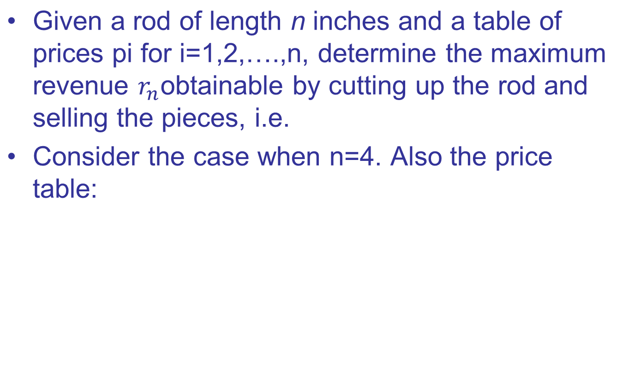

Rod Cutting Problem

Slide 22
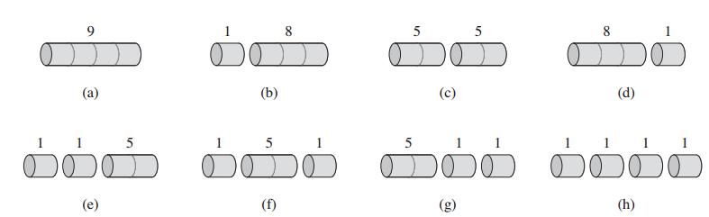
Rod Cutting Problem
Consider the case when n=4. Also the price table:
All the ways to cut up a rod of 4 inches in length, including the way with no cuts at all

Slide 23
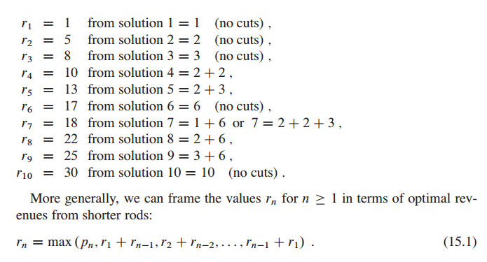
Rod cutting
General solution:

Slide 24
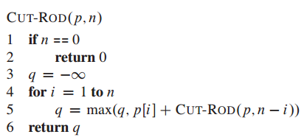
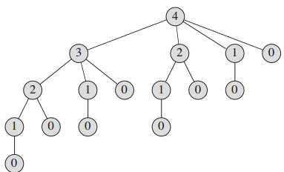
Rod cutting
Recursive top-down implementation
Is it efficient? Why?

Slide 25
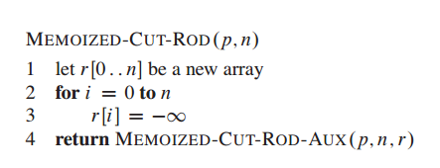
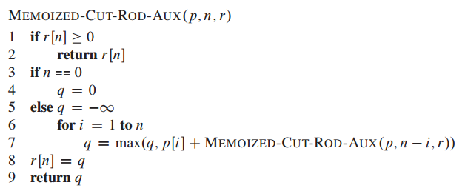
Using DP for optimal rod cutting
Solve using op-down with memorization

Slide 26
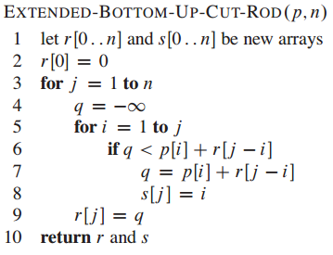
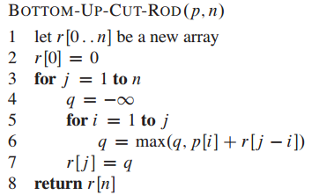
Using DP for optimal rod cutting
Bottom-up version:

Slide 27
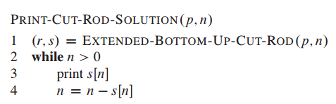

Using DP for optimal rod cutting
Bottom-up version:
Example: call EXTENDED-BOTTOM-UP-CUT-ROD(p, 10); or call print-cut-rod(P,10).

Slide 28
Matrix-chain Multiplication
Suppose we have a sequence or chain A₁, A₂, …, A_{n} of n matrices to be multiplied
  That is, we want to compute the product A₁A₂…A_{n}
There are many possible ways (parenthesizations) to compute the product

Slide 29
Matrix-chain Multiplication
Example: consider the chain A₁, A₂, A₃, A₄ of 4 matrices
  Let us compute the product A₁A₂A₃A₄
There are 5 possible ways:
  (A₁(A₂(A₃A₄)))
  (A₁((A₂A₃)A₄))
  ((A₁A₂)(A₃A₄))
  ((A₁(A₂A₃))A₄)
  (((A₁A₂)A₃)A₄)

Slide 30
Matrix-chain Multiplication …contd
To compute the number of scalar multiplications necessary, we must know:
  Algorithm to multiply two matrices
  Matrix dimensions
Can you write the algorithm to multiply two matrices?

Slide 31
Algorithm to Multiply 2 Matrices
Input: Matrices A_{p×q} and B_{q×r} (with dimensions p×q and q×r)
Result: Matrix C_{p×r} resulting from the product A·B
MATRIX-MULTIPLY(A_{p×q} , B_{q×r})
1. for i ← 1 to p
2. for j ← 1 to r
3. C[i, j] ← 0
4. for k ← 1 to q
5. C[i, j] ← C[i, j] + A[i, k] · B[k, j]
6. return C
Scalar multiplication in line 5 dominates time to compute C
Number of scalar multiplications = pqr

Slide 32
Matrix-chain Multiplication …contd
Example: Consider three matrices A_{10×100}, B_{100×5}, and C_{5×50}
There are 2 ways to parenthesize
  ((AB)C) = D_{10×5} · C_{5×50}
    AB ⇒ 10·100·5=5,000 scalar multiplications
    DC ⇒ 10·5·50 =2,500 scalar multiplications
  (A(BC)) = A_{10×100} · E_{100×50}
    BC ⇒ 100·5·50=25,000 scalar multiplications
    AE ⇒ 10·100·50 =50,000 scalar multiplications
Total: 7,500
Total: 75,000

Slide 33
Matrix-Chain Multiplication
Given a chain of matrices ⟨A₁, A₂, …, A_{n}⟩, where for i = 1, 2, …, n matrix A_{i} has dimensions p_{i-1}x p_{i}, fully parenthesize the product A₁ ⋅ A₂ ⋅⋅⋅ A_{n} in a way that minimizes the number of scalar multiplications.
A₁ ⋅ A₂ ⋅⋅⋅ A_{i} ⋅ A_{i+1} ⋅⋅⋅ A_{n}
p₀ x p₁ p₁ x p₂ p_{i-1} x p_{i} p_{i} x p_{i+1} p_{n-1} x p_{n}

Slide 34
2. A Recursive Solution
Consider the subproblem of parenthesizing A_{i…j} = A_{i} A_{i+1} ⋅⋅⋅ A_{j} for 1 ≤ i ≤ j ≤ n
= A_{i…k} A_{k+1…j} for i ≤ k < j
Assume that the optimal parenthesization splits the product A_{i} A_{i+1} ⋅⋅⋅ A_{j} at k (i ≤ k < j)
  m[i, j] =
p_{i-1}p_{k}p_{j}
m[i, k]
m[k+1,j]
m[i, k] + m[k+1, j] + p_{i-1}p_{k}p_{j}
min # of multiplications
to compute A_{i…k}
min # of multiplications
to compute A_{k+1…j}
# of multiplications
to compute A_{i…k}A_{k…j}

Slide 35
3. Computing the Optimal Costs
0 if i = j
m[i, j] = min {m[i, k] + m[k+1, j] + p_{i-1}p_{k}p_{j}} if i < j
^{i≤k<j}
Length = 1: i = j, i = 1, 2, …, n
Length = 2: j = i + 1, i = 1, 2, …, n-1
second
first
1
2
3
n
n
m[1, n] gives the optimal
solution to the problem
j
Compute rows from bottom to top and from left to right
In a similar matrix s we keep the optimal values of k
3
2
1
i

Slide 36
Example: min {m[i, k] + m[k+1, j] + p_{i-1}p_{k}p_{j}}
m[2, 2] + m[3, 5] + p₁p₂p₅
m[2, 3] + m[4, 5] + p₁p₃p₅
m[2, 4] + m[5, 5] + p₁p₄p₅
k = 2
m[2, 5] = min
k = 3
k = 4
1
2
3
4
5
6
6
5
Values m[i, j] depend only on values that have been previously computed
4
j
3
2
1
i

Slide 37
Multiply 4 Matrices: A×B×C×D (1)
Compute the costs in the bottom-up manner
  First we consider AB, BC, CD
  No need to consider AC or BD
ABCD
A(BCD)
(AB)(CD)
(ABC)D
ABC
BCD
A(BC)
(AB)C
B(CD)
(BC)D
AB
BC
CD
A
B
C
D

Slide 38
Multiply 4 Matrices: A×B×C×D (2)
Compute the costs in the bottom-up manner
  Then we consider A(BC), (AB)C, B(CD), (BC)D
  No need to consider (AB)D, A(CD)
ABCD
A(BCD)
(AB)(CD)
(ABC)D
ABC
BCD
A(BC)
(AB)C
B(CD)
(BC)D
AB
BC
CD
A
B
C
D

Slide 39
Multiply 4 Matrices: A×B×C×D (3)
Compute the costs in the bottom-up manner
Select minimum cost matrix calculations of ABC & BCD
ABCD
A(BCD)
(AB)(CD)
(ABC)D
ABC
BCD
min
min
A(BC)
(AB)C
B(CD)
(BC)D
AB
BC
CD
A
B
C
D

Slide 40
Multiply 4 Matrices: A×B×C×D (4)
Compute the costs in the bottom-up manner
  We now consider A(BCD), (AB)(CD), (ABC)D
ABCD
A(BCD)
(AB)(CD)
(ABC)D
ABC
BCD
A(BC)
(AB)C
B(CD)
(BC)D
AB
BC
CD
A
B
C
D

Slide 41
Multiply 4 Matrices: A×B×C×D (5)
Compute the costs in the bottom-up manner
  Finally choose the cheapest cost plan for matrix calculations
ABCD
min
A(BCD)
(AB)(CD)
(ABC)D
ABC
BCD
A(BC)
(AB)C
B(CD)
(BC)D
AB
BC
CD
A
B
C
D

Slide 42
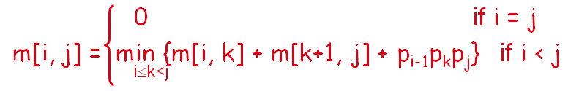
Example
M:
 | 1 | 2 | 3 | 4
1 | 0 | 1200 | 700 | 1400
2 | n/a | 0 | 400 | 650
3 | n/a | n/a | 0 | 10,000
4 | n/a | n/a | n/a | 0
1: A is 30x1
2: B is 1x40
3: C is 40x10
4: D is 10x25
S:
1
1
1
2
3
3

Slide 43
Example:
P₀=10
p₁=5
p₂=1
p₃=10
p₄=2
p₅=10
  [10×5]×[5×1]×[1×10]×[10×2]×[2×10]
1
2
3
4
5
1
2
3
4
5
1
1
2
2
3
3
4
4
5
5
c(i,j), i ≤ j
kay(i,j), i ≤ j

Slide 44
Example:
P₀=10
p₁=5
p₂=1
p₃=10
p₄=2
p₅=10
  [10×5]×[5×1]×[1×10]×[10×2]×[2×10]
1
2
3
4
5
1
2
3
4
5
1
0
1
2
0
2
3
0
3
4
0
4
5
0
5
c(i,j), i ≤ j
kay(i,j), i ≤ j

Slide 45
Example:
P₀=10
p₁=5
p₂=1
p₃=10
p₄=2
p₅=10
  [10×5]×[5×1]×[1×10]×[10×2]×[2×10]
  i=1, j=2, k=1 , p₀p₁p₂=10*5*1=50 m[1,2]=0+0+50=50
  kay(i,i+1) = 1
1
2
3
4
5
1
2
3
4
5
1
0
50
1
1
2
0
2
3
0
3
4
0
4
5
0
5
c(i,j), i ≤ j
kay(i,j), i ≤ j

Slide 46
Example:
P₀=10
p₁=5
p₂=1
p₃=10
p₄=2
p₅=10
  s = 0, [10×5]×[5×1]×[1×10]×[10×2]×[2×10]
1
2
3
4
5
1
2
3
4
5
1
0
50
1
1
2
0
50
2
2
3
0
20
3
3
4
0
200
4
4
5
0
5
c(i,j), i ≤ j
kay(i,j), i ≤ j

Slide 47
Example:
P₀=10
p₁=5
p₂=1
p₃=10
p₄=2
p₅=10
  s = 1, [10×5]×[5×1]×[1×10]×[10×2]×[2×10], k=1,2, i=1,j=3
  K=1, m[1,1] +m[2,3]+ p₀p₁p₃= 0+50+10*5*10=550
  K=2, m[1,2] +m[3,3]+ p₀p₂p₃= 50+0+10*1*10=150
1
2
3
4
5
1
2
3
4
5
1
0
50
150
1
1
2
2
0
50
2
2
3
0
20
3
3
4
0
200
4
4
5
0
5
c(i,j), i ≤ j
kay(i,j), i ≤ j

Slide 48
Example
P₀=10
p₁=5
p₂=1
p₃=10
p₄=2
p₅=10
  s = 1, [10×5]×[5×1]×[1×10]×[10×2]×[2×10], k=(2,3), i=2,j=4
  K=2, m[2,2] +m[3,4]+ p₁p₂p₄= 0+20+5*1*2=30
  K=3, m[2,3] +m[4,4]+ p₁p₃p₄ = 50+0+5*10*2=150
1
2
3
4
5
1
2
3
4
5
1
0
50
150
1
1
2
2
0
50
30
2
2
2
3
0
20
3
3
4
0
200
4
4
5
0
5
c(i,j), i ≤ j
kay(i,j), i ≤ j

Slide 49
Example
P₀=10
p₁=5
p₂=1
p₃=10
p₄=2
p₅=10
  [10×5]×[5×1]×[1×10]×[10×2]×[2×10], i=3,j=5, k=(3,4)
  K=3, m[3,3] +m[4,5]+ p₂p₃p₅= 0+200+1*10*10=300
  K=4, m[3,4] +m[5,5]+ p₂p₄p₅ = 20+0+1*2*10=40
1
2
3
4
5
1
2
3
4
5
1
0
50
150
1
1
2
2
0
50
30
2
2
2
3
0
20
40
3
3
4
4
0
200
4
4
5
0
5
c(i,j), i ≤ j
kay(i,j), i ≤ j

Slide 50
Example
P₀=10
p₁=5
p₂=1
p₃=10
p₄=2
p₅=10
  [10×5]×[5×1]×[1×10]×[10×2]×[2×10], i=1,j=4, k=1,2,3
  K=1, m[1,1] +m[2,4]+ p₀p₁p₄= 0+30+10*5*2=130
  K=2, m[1,2] +m[3,4]+ p₀p₂p₄ = 50+20+10*1*2=90
  K=3, m[1,3] +m[4,4]+ p₀p₃p₄ = 150+0+10*10*2=350
1
2
3
4
5
1
2
3
4
5
1
0
50
150
90
1
1
2
2
2
0
50
30
2
2
2
3
0
20
40
3
3
4
4
0
200
4
4
5
0
5
c(i,j), i ≤ j
kay(i,j), i ≤ j

Slide 51
Example
P₀=10
p₁=5
p₂=1
p₃=10
p₄=2
p₅=10
  s = 1, [10×5]×[5×1]×[1×10]×[10×2]×[2×10], i=2,j=5, k=(2,3,4)
  K=2, m[2,2] +m[3,5]+ p₁p₂p₅= 0+40+5*1*10=90
  K=3, m[2,3] +m[4,5]+ p₁p₃p₄ = 50+200+5*10*10=750
  K=4, m[2,4] +m[5,5]+ p₁p₄p₄ = 30+0+5*2*10=130
1
2
3
4
5
1
2
3
4
5
1
0
50
150
90
1
1
2
2
2
0
50
30
90
2
2
2
2
3
0
20
40
3
3
4
4
0
200
4
4
5
0
5
c(i,j), i ≤ j
kay(i,j), i ≤ j

Slide 52
Example
  [10×5]×[5×1]×[1×10]×[10×2]×[2×10]
1
2
3
4
5
1
2
3
4
5
1
0
50
150
90
190
1
1
2
2
2
2
0
50
30
90
2
2
2
2
3
0
20
40
3
3
4
4
0
200
4
4
5
0
5
c(i,j), i ≤ j
kay(i,j), i ≤ j

Slide 53
Example
Optimal multiplication sequence
  kay(1,5) = 2
  ▶ M₁₅ = M₁₂×M₃₅
1
2
3
4
5
1
2
3
4
5
1
0
50
150
90
190
1
1
2
2
2
2
0
50
30
90
2
2
2
2
3
0
20
40
3
3
4
4
0
200
4
4
5
0
5
c(i,j), i ≤ j
kay(i,j), i ≤ j

Slide 54
Example
  M₁₅ = M₁₂×M₃₅
  kay(1,2) = 1 ▶ M₁₂ = M₁₁×M₂₂
  → M₁₅ = (M₁₁×M₂₂)×M₃₅
1
2
3
4
5
1
2
3
4
5
1
0
50
150
90
190
1
1
2
2
2
2
0
50
30
90
2
2
2
2
3
0
20
40
3
3
4
4
0
200
4
4
5
0
5
c(i,j), i ≤ j
kay(i,j), i ≤ j

Slide 55
Example
  M₁₅ = (M₁₁×M₂₂)×M₃₅
  Kay(3,5) = 4 ▶ M₃₅ = M₃₄×M₅₅
  → M₁₅ = (M₁₁×M₂₂)×(M₃₄×M₅₅)
1
2
3
4
5
1
2
3
4
5
1
0
50
150
90
190
1
1
2
2
2
2
0
50
30
90
2
2
2
2
3
0
20
40
3
3
4
4
0
200
4
4
5
0
5
c(i,j), i ≤ j
kay(i,j), i ≤ j

Slide 56
Example
  M₁₅ = (M₁₁×M₂₂)×(M₃₄×M₅₅)
  Kay(3,4) = 3 ▶ M₃₄ = M₃₃×M₄₄
  → M₁₅ = (M₁₁×M₂₂)×((M₃₃×M₄₄)×M₅₅)
1
2
3
4
5
1
2
3
4
5
1
0
50
150
90
190
1
1
2
2
2
2
0
50
30
90
2
2
2
2
3
0
20
40
3
3
4
4
0
200
4
4
5
0
5
c(i,j), i ≤ j
kay(i,j), i ≤ j

Slide 57
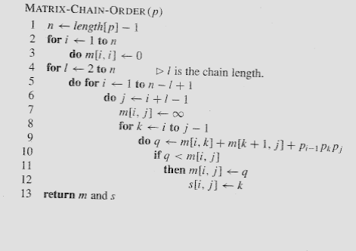
Matrix-Chain-Order(p)
O(N³)

Slide 58
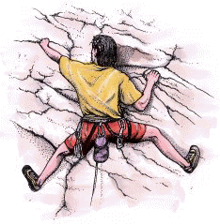
Rock Climbing Problem
A rock climber wants to get from the bottom of a rock to the top by the safest possible path.
At every step, he reaches for handholds above him; some holds are safer than other.
From every place, he can only reach a few nearest handholds.

Slide 59

Rock climbing (cont)
Suppose we have a wall instead of the rock.
4
5
3
2
At every step our climber can reach exactly three handholds: above, above and to the right and above and to the left.
There is a table of “danger ratings” provided. The “Danger” of a path is the sum of danger ratings of all handholds on the path.

Slide 60
Rock Climbing (cont)
We represent the wall as a table.
Every cell of the table contains the danger rating of the corresponding block.
2 | 8 | 9 | 5 | 8
4 | 4 | 6 | 2 | 3
5 | 7 | 5 | 6 | 1
3 | 2 | 5 | 4 | 8
2
5
4
2
5
1
2
4
The obvious greedy algorithm does not give an
optimal solution.
The rating of this path is 13.
The rating of an optimal path is 12.
However, we can solve this problem by a dynamic programming strategy in polynomial time.

Slide 61
Idea: once we know the rating of a path to every handhold on a layer, we can easily compute the ratings of the paths to the holds on the next layer.
For the top layer, that gives us an answer to the problem itself.

Slide 62
For every handhold, there is only one “path” rating. Once we have reached a hold, we don’t need to know how we got there to move to the next level.
This is called an “optimal substructure” property. Once we know optimal solutions to subproblems, we can compute an optimal solution to the problem itself.

Slide 63
Recursive solution:
To find the best way to get to stone j in row i, check the cost of getting to the stones
  (i-1,j-1),
  (i-1,j) and
  (i-1,j+1), and take the cheapest.
Problem: each recursion level makes three calls for itself, making a total of 3^{n} calls – too much!

Slide 64
Solution - memorization
We query the value of A(i,j) over and over again.
Instead of computing it each time, we can compute it once, and remember the value.
A simple recurrence allows us to compute A(i,j) from values below.

Slide 65
Dynamic programming
Step 1: Describe an array of values you want to compute.
Step 2: Give a recurrence for computing later values from earlier (bottom-up).
Step 3: Give a high-level program.
Step 4: Show how to use values in the array to compute an optimal solution.

Slide 66
Rock climbing: step 1.
Step 1: Describe an array of values you want to compute.
For 1 ≤ i ≤ n and 1 ≤ j ≤ m, define A(i,j) to be the cumulative rating of the least dangerous path from the bottom to the hold (i,j).
The rating of the best path to the top will be the minimal value in the last row of the array.

Slide 67
Rock climbing: step 2.
Step 2: Give a recurrence for computing later values from earlier (bottom-up).
Let C(i,j) be the rating of the hold (i,j). There are three cases for A(i,j):
Left (j=1): C(i,j)+min{A(i-1,j),A(i-1,j+1)}
Right (j=m): C(i,j)+min{A(i-1,j-1),A(i-1,j)}
Middle: C(i,j)+min{A(i-1,j-1),A(i-1,j),A(i-1,j+1)}
For the first row (i=1), A(i,j)=C(i,j).

Slide 68
Rock climbing: simpler step 2
Add initialization row: A(0,j)=0. No danger to stand on the ground.
Add two initialization columns: A(i,0)=A(i,m+1)=∞. It is infinitely dangerous to try to hold on to the air where the wall ends.
Now the recurrence becomes, for every i,j:
A(i,j) = C(i,j)+min{A(i-1,j-1),A(i-1,j),A(i-1,j+1)}

Slide 69
Rock climbing: example
C(i,j):
A(i,j):
3 | 2 | 5 | 4 | 8
5 | 7 | 5 | 6 | 1
4 | 4 | 6 | 2 | 3
2 | 8 | 9 | 5 | 8
i\j | 0 | 1 | 2 | 3 | 4 | 5 | 6
0
1
2
3
4
i\j | 0 | 1 | 2 | 3 | 4 | 5 | 6
0 | ∞ | 0 | 0 | 0 | 0 | 0 | ∞
1 | ∞ |  |  |  |  |  | ∞
2 | ∞ |  |  |  |  |  | ∞
3 | ∞ |  |  |  |  |  | ∞
4 | ∞ |  |  |  |  |  | ∞
Initialization: A(i,0)=A(i,m+1)=∞, A(0,j)=0

Slide 70
Rock climbing: example
C(i,j):
A(i,j):
3 | 2 | 5 | 4 | 8
5 | 7 | 5 | 6 | 1
4 | 4 | 6 | 2 | 3
2 | 8 | 9 | 5 | 8
i\j | 0 | 1 | 2 | 3 | 4 | 5 | 6
0 | ∞ | 0 | 0 | 0 | 0 | 0 | ∞
1 | ∞ | 3 | 2 | 5 | 4 | 8 | ∞
2 | ∞ |  |  |  |  |  | ∞
3 | ∞ |  |  |  |  |  | ∞
4 | ∞ |  |  |  |  |  | ∞
i\j | 0 | 1 | 2 | 3 | 4 | 5 | 6
0 | ∞ | 0 | 0 | 0 | 0 | 0 | ∞
1 | ∞ |  |  |  |  |  | ∞
2 | ∞ |  |  |  |  |  | ∞
3 | ∞ |  |  |  |  |  | ∞
4 | ∞ |  |  |  |  |  | ∞
The values in the first row are the same as C(i,j).

Slide 71
Rock climbing: example
C(i,j):
A(i,j):
3 | 2 | 5 | 4 | 8
5 | 7 | 5 | 6 | 1
4 | 4 | 6 | 2 | 3
2 | 8 | 9 | 5 | 8
i\j | 0 | 1 | 2 | 3 | 4 | 5 | 6
0 | ∞ | 0 | 0 | 0 | 0 | 0 | ∞
1 | ∞ | 3 | 2 | 5 | 4 | 8 | ∞
2 | ∞ | 7 |  |  |  |  | ∞
3 | ∞ |  |  |  |  |  | ∞
4 | ∞ |  |  |  |  |  | ∞
A(2,1)=5+min{∞,3,2}=7.

Slide 72
Rock climbing: example
C(i,j):
A(i,j):
3 | 2 | 5 | 4 | 8
5 | 7 | 5 | 6 | 1
4 | 4 | 6 | 2 | 3
2 | 8 | 9 | 5 | 8
i\j | 0 | 1 | 2 | 3 | 4 | 5 | 6
0 | ∞ | 0 | 0 | 0 | 0 | 0 | ∞
1 | ∞ | 3 | 2 | 5 | 4 | 8 | ∞
2 | ∞ | 7 | 9 |  |  |  | ∞
3 | ∞ |  |  |  |  |  | ∞
4 | ∞ |  |  |  |  |  | ∞
A(2,1)=5+min{∞,3,2}=7. A(2,2)=7+min{3,2,5}=9

Slide 73
Rock climbing: example
C(i,j):
A(i,j):
3 | 2 | 5 | 4 | 8
5 | 7 | 5 | 6 | 1
4 | 4 | 6 | 2 | 3
2 | 8 | 9 | 5 | 8
i\j | 0 | 1 | 2 | 3 | 4 | 5 | 6
0 | ∞ | 0 | 0 | 0 | 0 | 0 | ∞
1 | ∞ | 3 | 2 | 5 | 4 | 8 | ∞
2 | ∞ | 7 | 9 | 7 |  |  | ∞
3 | ∞ |  |  |  |  |  | ∞
4 | ∞ |  |  |  |  |  | ∞
A(2,1)=5+min{∞,3,2}=7. A(2,2)=7+min{3,2,5}=9
A(2,3)=5+min{2,5,4}=7.

Slide 74
Rock climbing: example
C(i,j):
A(i,j):
3 | 2 | 5 | 4 | 8
5 | 7 | 5 | 6 | 1
4 | 4 | 6 | 2 | 3
2 | 8 | 9 | 5 | 8
i\j | 0 | 1 | 2 | 3 | 4 | 5 | 6
0 | ∞ | 0 | 0 | 0 | 0 | 0 | ∞
1 | ∞ | 3 | 2 | 5 | 4 | 8 | ∞
2 | ∞ | 7 | 9 | 7 | 10 | 5 | ∞
3 | ∞ |  |  |  |  |  | ∞
4 | ∞ |  |  |  |  |  | ∞
The best cumulative rating on the second row is 5.

Slide 75
Rock climbing: example
C(i,j):
A(i,j):
3 | 2 | 5 | 4 | 8
5 | 7 | 5 | 6 | 1
4 | 4 | 6 | 2 | 3
2 | 8 | 9 | 5 | 8
i\j | 0 | 1 | 2 | 3 | 4 | 5 | 6
0 | ∞ | 0 | 0 | 0 | 0 | 0 | ∞
1 | ∞ | 3 | 2 | 5 | 4 | 8 | ∞
2 | ∞ | 7 | 9 | 7 | 10 | 5 | ∞
3 | ∞ | 11 | 11 | 13 | 7 | 8 | ∞
4 | ∞ |  |  |  |  |  | ∞
The best cumulative rating on the third row is 7.

Slide 76
Rock climbing: example
C(i,j):
A(i,j):
3 | 2 | 5 | 4 | 8
5 | 7 | 5 | 6 | 1
4 | 4 | 6 | 2 | 3
2 | 8 | 9 | 5 | 8
i\j | 0 | 1 | 2 | 3 | 4 | 5 | 6
0 | ∞ | 0 | 0 | 0 | 0 | 0 | ∞
1 | ∞ | 3 | 2 | 5 | 4 | 8 | ∞
2 | ∞ | 7 | 9 | 7 | 10 | 5 | ∞
3 | ∞ | 11 | 11 | 13 | 7 | 8 | ∞
4 | ∞ | 13 | 19 | 16 | 12 | 15 | ∞
The best cumulative rating on the last row is 12.

Slide 77
Rock climbing: example
C(i,j):
A(i,j):
3 | 2 | 5 | 4 | 8
5 | 7 | 5 | 6 | 1
4 | 4 | 6 | 2 | 3
2 | 8 | 9 | 5 | 8
i\j | 0 | 1 | 2 | 3 | 4 | 5 | 6
0 | ∞ | 0 | 0 | 0 | 0 | 0 | ∞
1 | ∞ | 3 | 2 | 5 | 4 | 8 | ∞
2 | ∞ | 7 | 9 | 7 | 10 | 5 | ∞
3 | ∞ | 11 | 11 | 13 | 7 | 8 | ∞
4 | ∞ | 13 | 19 | 16 | 12 | 15 | ∞
The best cumulative rating on the last row is 12.
So the rating of the best path to the top is 12.

Slide 78
Rock climbing example: step 4
C(i,j):
A(i,j):
3 | 2 | 5 | 4 | 8
5 | 7 | 5 | 6 | 1
4 | 4 | 6 | 2 | 3
2 | 8 | 9 | 5 | 8
i\j | 0 | 1 | 2 | 3 | 4 | 5 | 6
0 | ∞ | 0 | 0 | 0 | 0 | 0 | ∞
1 | ∞ | 3 | 2 | 5 | 4 | 8 | ∞
2 | ∞ | 7 | 9 | 7 | 10 | 5 | ∞
3 | ∞ | 11 | 11 | 13 | 7 | 8 | ∞
4 | ∞ | 13 | 19 | 16 | 12 | 15 | ∞
To find the actual path we need to retrace backwards
the decisions made during the calculation of A(i,j).

Slide 79
Rock climbing example: step 4
C(i,j):
A(i,j):
i\j | 0 | 1 | 2 | 3 | 4 | 5 | 6
0 | ∞ | 0 | 0 | 0 | 0 | 0 | ∞
1 | ∞ | 3 | 2 | 5 | 4 | 8 | ∞
2 | ∞ | 7 | 9 | 7 | 10 | 5 | ∞
3 | ∞ | 11 | 11 | 13 | 7 | 8 | ∞
4 | ∞ | 13 | 19 | 16 | 12 | 15 | ∞
3 | 2 | 5 | 4 | 8
5 | 7 | 5 | 6 | 1
4 | 4 | 6 | 2 | 3
2 | 8 | 9 | 5 | 8
The last hold was (4,4).
To find the actual path we need to retrace backwards
the decisions made during the calculation of A(i,j).

Slide 80
Rock climbing example: step 4
C(i,j):
A(i,j):
i\j | 0 | 1 | 2 | 3 | 4 | 5 | 6
0 | ∞ | 0 | 0 | 0 | 0 | 0 | ∞
1 | ∞ | 3 | 2 | 5 | 4 | 8 | ∞
2 | ∞ | 7 | 9 | 7 | 10 | 5 | ∞
3 | ∞ | 11 | 11 | 13 | 7 | 8 | ∞
4 | ∞ | 13 | 19 | 16 | 12 | 15 | ∞
3 | 2 | 5 | 4 | 8
5 | 7 | 5 | 6 | 1
4 | 4 | 6 | 2 | 3
2 | 8 | 9 | 5 | 8
The hold before the last
was (3,4), since
min{13,7,8} was 7.
To find the actual path we need to retrace backwards
the decisions made during the calculation of A(i,j).

Slide 81
Rock climbing example: step 4
C(i,j):
A(i,j):
i\j | 0 | 1 | 2 | 3 | 4 | 5 | 6
0 | ∞ | 0 | 0 | 0 | 0 | 0 | ∞
1 | ∞ | 3 | 2 | 5 | 4 | 8 | ∞
2 | ∞ | 7 | 9 | 7 | 10 | 5 | ∞
3 | ∞ | 11 | 11 | 13 | 7 | 8 | ∞
4 | ∞ | 13 | 19 | 16 | 12 | 15 | ∞
3 | 2 | 5 | 4 | 8
5 | 7 | 5 | 6 | 1
4 | 4 | 6 | 2 | 3
2 | 8 | 9 | 5 | 8
The hold before that
was (2,5), since
min{7,10,5} was 5.
To find the actual path we need to retrace backwards
the decisions made during the calculation of A(i,j).

Slide 82
Rock climbing example: step 4
C(i,j):
A(i,j):
i\j | 0 | 1 | 2 | 3 | 4 | 5 | 6
0 | ∞ | 0 | 0 | 0 | 0 | 0 | ∞
1 | ∞ | 3 | 2 | 5 | 4 | 8 | ∞
2 | ∞ | 7 | 9 | 7 | 10 | 5 | ∞
3 | ∞ | 11 | 11 | 13 | 7 | 8 | ∞
4 | ∞ | 13 | 19 | 16 | 12 | 15 | ∞
3 | 2 | 5 | 4 | 8
5 | 7 | 5 | 6 | 1
4 | 4 | 6 | 2 | 3
2 | 8 | 9 | 5 | 8
Finally, the first hold
was (1,4), since
min{5,4,8} was 4.
To find the actual path we need to retrace backwards
the decisions made during the calculation of A(i,j).

Slide 83
Rock climbing example: step 4
C(i,j):
A(i,j):
i\j | 0 | 1 | 2 | 3 | 4 | 5 | 6
0 | ∞ | 0 | 0 | 0 | 0 | 0 | ∞
1 | ∞ | 3 | 2 | 5 | 4 | 8 | ∞
2 | ∞ | 7 | 9 | 7 | 10 | 5 | ∞
3 | ∞ | 11 | 11 | 13 | 7 | 8 | ∞
4 | ∞ | 13 | 19 | 16 | 12 | 15 | ∞
3 | 2 | 5 | 4 | 8
5 | 7 | 5 | 6 | 1
4 | 4 | 6 | 2 | 3
2 | 8 | 9 | 5 | 8
We are done!

Slide 84
Printing out the solution recursively
PrintBest(A,i,j) // Printing the best path ending at (i,j)
if (i==0) OR (j=0) OR (j=m+1)
return;
if (A[i-1,j-1]<=A[i-1,j]) AND (A[i-1,j-1]<=A[i-1,j+1])
PrintBest(A,i-1,j-1);
elseif (A[i-1,j]<=A[i-1,j-1]) AND (A[i-1,j]<=A[i-1,j+1])
PrintBest(A,i-1,j);
elseif (A[i-1,j+1]<=A[i-1,j-1]) AND (A[i-1,j+1]<=A[i-1,j])
PrintBest(A,i-1,j+1);
printf(i,j)

Slide 85
Thanks All

